Slide 1
Investigating the Impact of SOLID Principles on OOP Development at AQDS & Dream Book Shop
M.M.M AASHIK MAHROOF
E230667

Slide 2
Introduction to OOP Paradigm
Object-Oriented Programming (OOP) is a paradigm centered around objects and classes.
Encourages reusability, scalability, and modularity.
Commonly used in business applications like AQDS and Dream Book Shop.
Focuses on real-world modeling and modularity
OOP is a programming paradigm based on the concept of “objects”
Objects contain both data (attributes) and behaviors (methods)
Supports abstraction, encapsulation, inheritance, and polymorphism
Encourages clear class design and structured architecture
Widely supported in modern languages (Java, Python, C++, etc.)
Enables efficient collaboration in teams through clear module separation

Slide 3
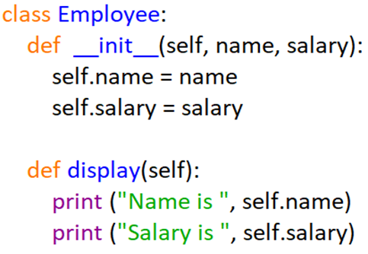
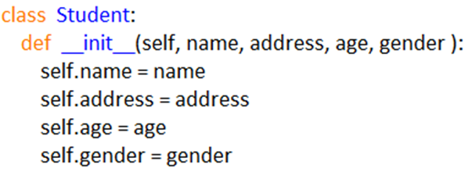

OOP Characteristics
Encapsulation
Protects internal object data by controlling access through public methods and private attributes.
Abstraction
Simplifies systems by exposing only necessary features, hiding internal implementation complexities.
Inheritance
Enables new classes to reuse and extend features from existing parent classes.
Polymorphism
Allows methods to perform different tasks depending on the object calling them.

Slide 4
Class Relationships
There are four types of Class Relationships in OOP
Association: An association is a symmetrical relationship between two classes. It has a feature called multiplicity/cardinality which indicates the number of instances involved in the association. Based on multiplicity, we can categorize associations into three types: one-to-one, one-to-many and many-to-many.
(e.g. Shop has Books).
Aggregation: This shows part-whole relationships between objects. An object can be a component/part of another object when there is an “Is-part-of” relationship. (e.g. Author writes Books).
Composition: This is a strong form of aggregation with a life time dependency between the “Whole” and the “parts”. The part/component belongs to just one “whole”. If the “whole” is destroyed, part is also destroyed.
(e.g. Book composed of Pages).
Inheritance: We can organize classes into a hierarchy when they have some common features. This will allow us to derive new classes from existing classes. (e.g. Admin is a User).

Slide 5
What is SOLID?
SOLID is a collection of five object-oriented design principles that may help you build more manageable and re-usable code based on well-designed, clearly organized classes.
SOLID is an acronym for five design principles in OOP:
S – Single Responsibility Principle
O – Open/Closed Principle
L – Liskov Substitution Principle
I – Interface Segregation Principle
D – Dependency Inversion Principle

Slide 6
Single Responsibility Principle
This implies that a class should have just one duty, as stated by its methods. If a class handles more than one duty, then you should break those duties into different classes.
Example:
Book Manager handles only book data.
Report Generator handles only reporting.
Open/Closed Principle
This implies Software object classes should be available for extension, but closed for alteration. It is okay to expand an existing class via sub-classing (Inheritance) and method overriding provided it does not affect existing code. Software entities should be open for extension, closed for modification.
Example:
Adding new book formats in Dream Book Shop without changing core logic

Slide 7
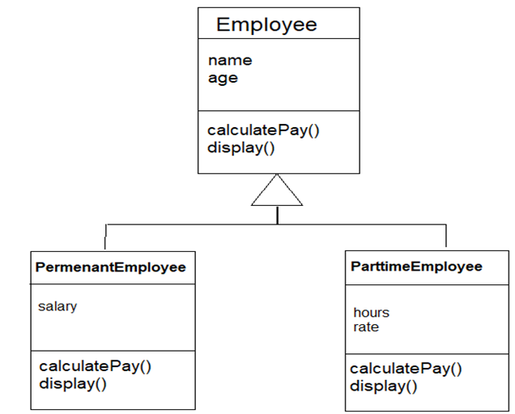
L - Liskov Substitution Principle
Invented by Barbara Liskov in 1988, this principle says that where a method expects a super class object as a parameter it can be substituted by a sub-class object. This means the same user code can work with different sub-class objects and produce sub-class specific behavior at different occasions. In other words, the user code behavior is Polymorphic. Subtypes must be substitutable for their base types.
Example: A Premium User can replace User in AQDS without breaking the system.
I - Interface Segregation Principle
Clients shouldn't be forced to depend on unused interfaces. An Interface is a specific form of a super class that includes just abstract methods (i.e. empty methods). The Interface Segregation Principle asserts that an Interface shall not require sub classes to implement its abstract methods.
Example:
Separate interfaces: IReader, IAuthor, IAdmin.

Slide 8
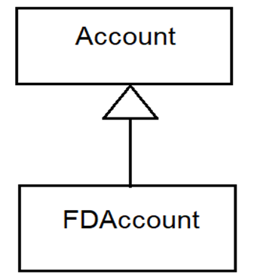
Dependency Inversion Principle
High-level modules shouldn't depend on low-level modules. Both should depend on abstractions. This principle says that classes that provide details must depend on abstractions and not the other way around. This implies that our design must start with Interface classes or Abstract classes.
Example:
FDAccount depends on the abstraction “Account” and its abstract method calculate Interest().

Slide 9

Clean Coding & Data Structures
Meaningful Names
Use descriptive names for variables, functions, and classes to make code more understandable and intuitive.
Modular Design
Break code into smaller functions or classes; improves maintainability, reusability, and team collaboration.
Consistent Formatting
Follow standard indentation, spacing, and naming styles to ensure readability across teams.
Avoid Code Duplication
Extract repeating logic into reusable functions or classes to reduce redundancy and bugs.
Proper Comments
Use comments to explain "why", not "what", especially when logic is complex or non-obvious.
Error Handling
Write clear and consistent exception handling to prevent crashes and improve reliability in data operations.

Slide 10
Impact on Data Structures and Algorithms
Cleaner Logic for Loops and Conditions
Using clean code ensures loops and conditions are straightforward, readable, and free from unnecessary logic.
Better Performance Tracking
Structured, clean code makes it easier to measure and improve algorithm performance and resource usage.
Reduces Complexity
By organizing logic and data clearly, clean code minimizes confusion in large, complex data processes.
Easier Testing and Debugging
Well-written code enables efficient testing of individual functions and quicker resolution of data-related bugs.

Slide 11
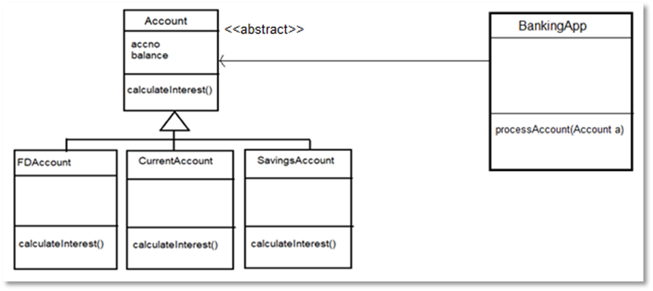
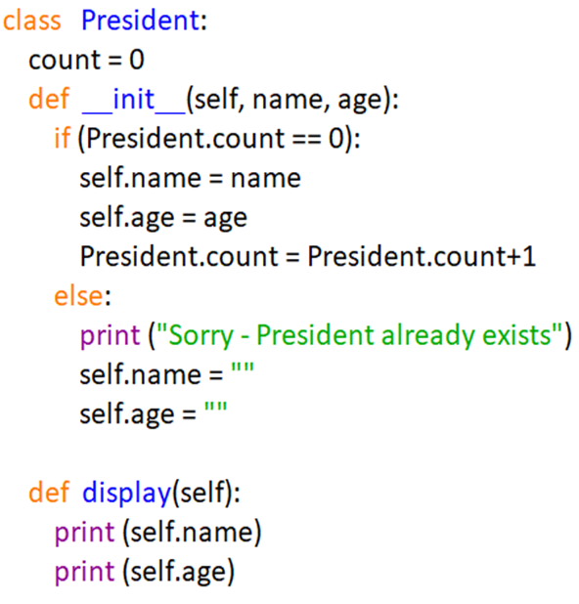
Creational Design Patterns
In software engineering, creational design patterns are design patterns that deal with object creations. They try to create objects in a manner suitable to the problem situation. Creational design patterns control object creations. They encapsulate knowledge about what objects they create
Example Patterns:
Abstract Factory Method Design Patterns
Singleton Method Design Pattern

Slide 12
Structural Design Patterns
Structural patterns form larger structures from individual components, generally of different classes. Structural patterns vary a great deal depending on what sort of structure is being created for what purpose.
Example Patterns:
Adapter
Composite
Example:
Adapter used to connect an old payment API with a new booking system.
Behavioral Design Patterns
Behavioural patterns describe interactions between objects. They focus on how objects communicate with each other. Behavioural patterns are concerned with assignment of responsibilities between objects.
Example Patterns:
Observer
Strategy
Example:
Strategy used to choose different discount strategies in checkout.

Slide 13
Impact of SOLID on OOP
Easier maintenance
Scalable architecture
Improved testing and debugging
Better team collaboration
Better scalability and testability
Reduces bugs and maintenance costs
Encourages team collaboration
Enables faster feature updates

Slide 14
Conclusion
OOP Enables Modular, Reusable Code
Object-Oriented Programming promotes structured, reusable components, reducing duplication and improving collaboration.
SOLID Enhances Structure and Adaptability
SOLID principles ensure flexible, scalable, and maintainable systems that adapt easily to new requirements.
Design Patterns Simplify Recurring Challenges
Design patterns provide tested solutions to common problems, improving development speed and consistency.
OOP and SOLID Create a Strong Foundation
Combining OOP and SOLID leads to robust, organized software architecture with long-term maintainability.
Clean Code Enhances Data Handling
Readable, organized code supports better data flow, manipulation, and algorithm performance across applications.

Slide 15
THANK YOU

